Slide 1
Thinking Like an Economist
Course: Microeconomics
Faculy:
Chapter-2
United int. university

Slide 2
Microeconomics & Macroeconomics
Economists try to address their subject with a scientist’s objectivity. Like all scientists, they make appropriate assumptions and build simplified models to understand the world around them.
The field of economics is traditionally divided into two broad subfields.
Microeconomics is the study of how households and firms make decisions and how they interact in specific markets. A micro-economist might study the effects of rent Control on housing in New York city, the impact of foreign competition on the U.S. Auto industry, or the effects of compulsory school attendance on workers’ Earnings.
Macroeconomics is the study of economy-wide phenomena. A macroeconomist might study the effects of borrowing by the federal Government, the changes over time in the economy’s rate of unemployment, or Alternative policies to promote growth in national living standards.

Slide 3
Positive versus Normative Analysis
Positive statements are descriptive. They make a claim about how the world is. Ex- Minimum-wage laws cause unemployment
Normative statements are prescriptive. They make a claim about how the world ought to be. Ex- The government should raise the minimum wage.

Slide 4
The Circular-Flow Diagram
Circular-flow diagram- a visual model of the economy that shows how dollars flow through markets among households and firms.
Firms produce goods and services using inputs, such as labor, land, and capital (buildings and machines). These inputs are called the Factors of Production. Households own the factors of production and consume all the goods and services that the firms produce.

Slide 5
The Circular-Flow Diagram

Slide 6
The Production Possibilities Frontier
The production possibilities frontier is a graph that shows the various combinations of output that the economy can possibly produce given the available factors of production and the available production technology that firms use to turn these factors into output.
Figure 2 shows this economy’s production possibilities frontier. If the economy uses all its resources in the car industry, it produces 1,000 cars and no computers. If it uses all its resources in the computer industry, it produces 3,000 computers and no cars. The two endpoints of the production possibilities frontier represent these extreme possibilities.

Slide 7
The Production Possibilities Frontier
Because resources are scarce, not every conceivable outcome is feasible. For example, no matter how resources are allocated between the two industries, the economy cannot produce the amount of cars and computers represented by point C.
Given the technology available for manufacturing cars and computers, the economy does not have enough of the factors of production to support that level of output. With the resources it has, the economy can produce at any point on or inside the production possibilities frontier, but it cannot produce at points outside the frontier.

Slide 8
The Production Possibilities Frontier
An outcome is said to be efficient if the economy is getting all it can from the scarce resources it has available. Points on (rather than inside) the production possibilities frontier represent efficient levels of production.
Point D represents an inefficient outcome. If the source of the inefficiency is eliminated, the economy can increase its production of both goods.
The slope of the PPF measures the opportunity cost of one good to the other.
The slope is bow shaped when the opportunity cost is not constant & it is a straight line when the opportunity cost is constant.

Slide 9
The Production Possibilities Frontier

Slide 10
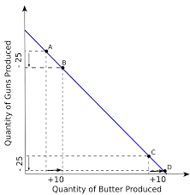
The Production Possibilities Frontier

Slide 11
A Shift in the Production Possibilities Frontier
Due to technological advancement, a good domestic production or a year of good international business, there might be growth of the economy.
This figure in the next slide illustrates what happens when an economy grows. Society can move production from a point on the old frontier to a point on the new frontier.
There will be shift in the PPF which will now enable the society to avail more products due to a higher production of any one of the good or both the goods.

Slide 12
A Shift in the Production Possibilities Frontier

Slide 13
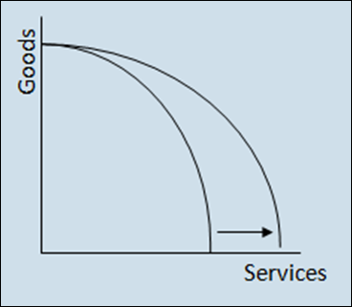
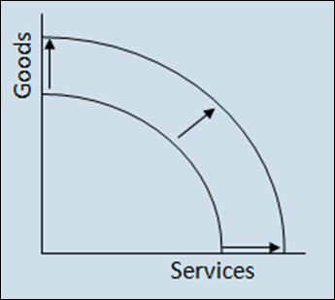
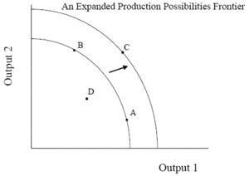
A Shift in the Production Possibilities Frontier

